Slide 1
Data Exploration and Analysis Project
Matthew Litaker
DSC 530

Slide 2
Research Question
Which physical feature has the most significant effect on housing costs?

Slide 3
Variables
Dependent Variable
Price – Price of the House
Explanatory Variables
Area – Square footage of the house
Bedrooms – Number of bedrooms in the house
Bathrooms – Number of bathrooms in the house
Stories – Number of stories in the house
Parking – Number of parking spaces with the house

Slide 4
Identifying and Handling Outliers
Box Charts were used to identify outliers. Outliers identified were considered outliers based on the few times a variable was represented by a value.
Although outliers were observed during the modeling process, they were retained to assess any potentially significant effects they might cause.

Slide 5
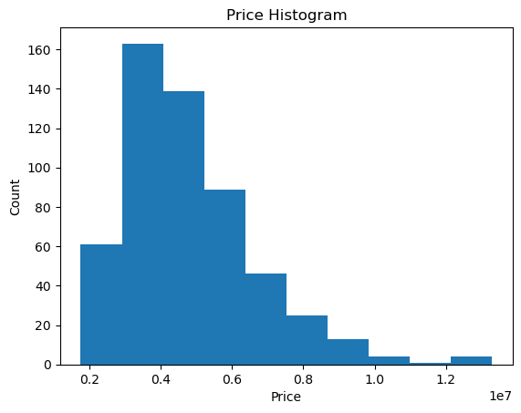
Dependent Variable: Price
Descriptive Characteristics:
Mean = 4766729.25
Mode = 3500000
Spread = 3498544355820.58
Tails = 1820000
1767150 1750000 1750000 1750000
Outliers:
Value over 1.2 million

Slide 6
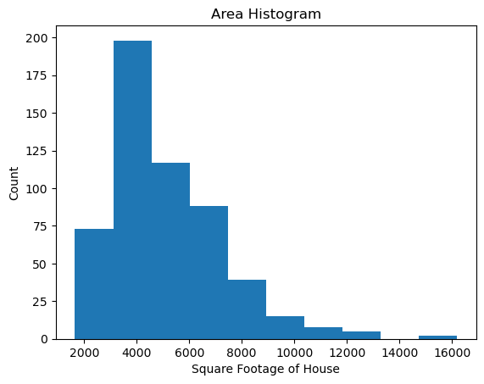
Explanatory Variable: Area
Descriptive Characteristics:
Mean = 5150.54
Mode = 6000
Spread = 4709512.06
Tails = 3000
2400
3620
2910
3850
Outliers:
Value over 11000

Slide 7
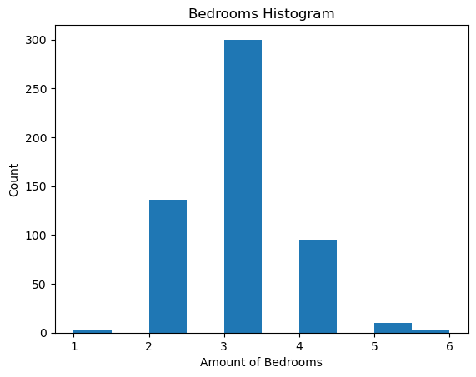
Explanatory Variable: Bedrooms
Descriptive Characteristics:
Mean = 2.97
Mode = 3
Spread = 0.54
Tails = 2
3
2
3
3
Outliers:
Value over 4

Slide 8
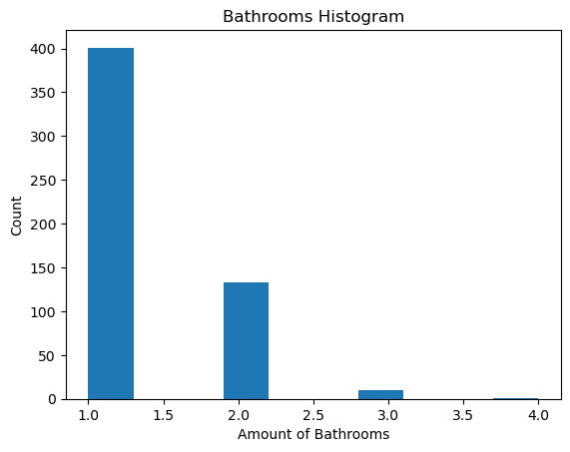
Explanatory Variable: Bathrooms
Descriptive Characteristics:
Mean = 1.29
Mode = 1
Spread = 0.25
Tails = 1
1
1
1
1
Outliers:
Value over 3

Slide 9
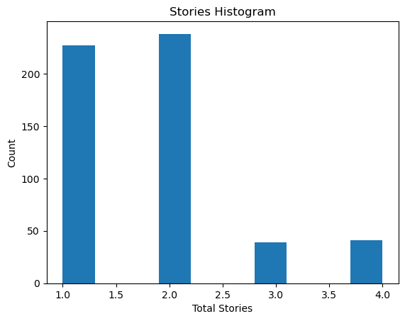
Explanatory Variable: Stories
Descriptive Characteristics:
Mean = 1.81
Mode = 2
Spread = 0.75
Tails = 1
1
1
1
2
Outliers:
Value over 3

Slide 10
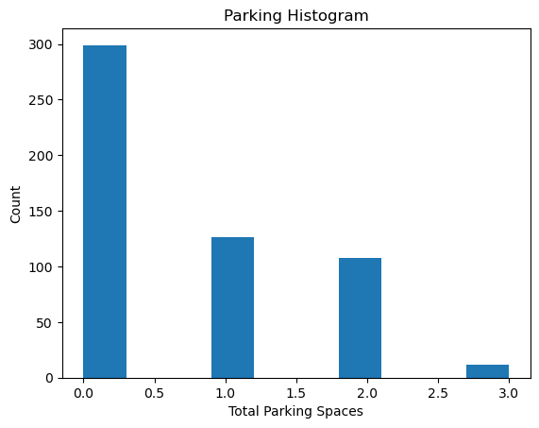
Explanatory Variable: Parking
Descriptive Characteristics:
Mean = 0.69
Mode = 0
Spread = 0.74
Tails = 2
0
0
0
0
Outliers:
Value over 2

Slide 11
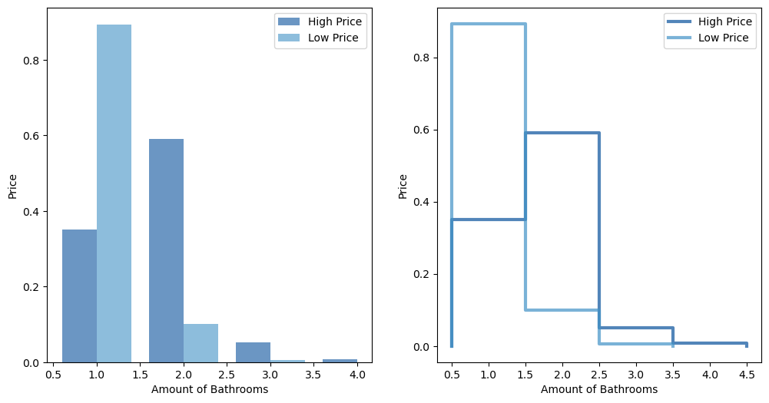
Probability Mass Function(PMF) comparing explanatory variable (Bathrooms) based on two scenarios (High Price and Low Price)

Slide 12
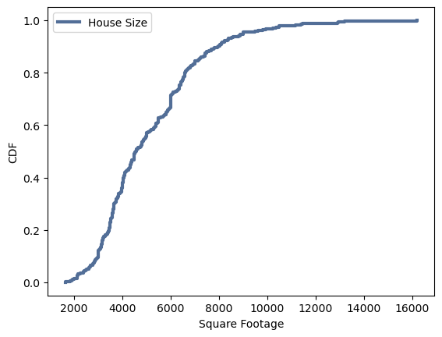
Cumulative Distribution Function(CDF) on an explanatory variable (Area)
The CDF shows that houses begin to rise in value as square footage becomes larger. This directly aligns with exploring which physical feature has the most significant effect on housing costs.

Slide 13
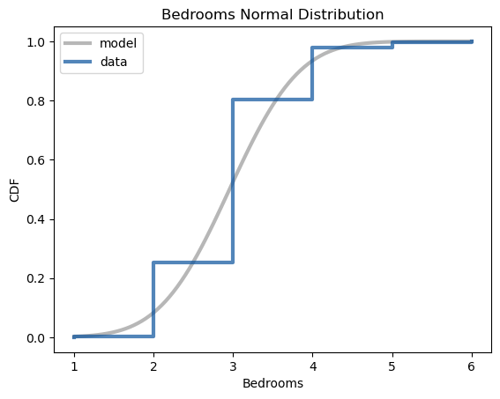
Analytical Distribution (Normal) on an explanatory variable (Bedrooms)
Considering that the variable tested for this distribution has smaller values, the data appears to follow the model well. This applies to the dataset by showing the number of bedrooms as the percentile rises.

Slide 14
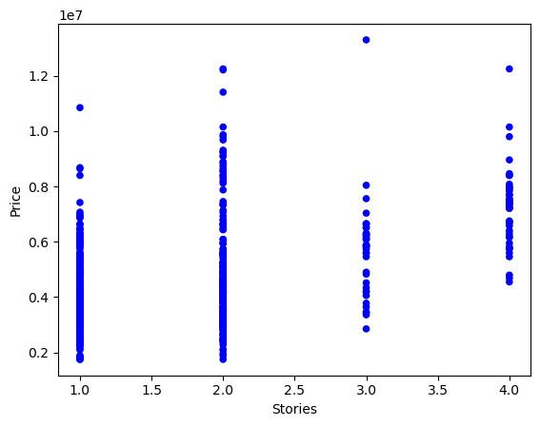
Scatter plot and values (Covariance, Correlation, and Spearman Correlation) comparing the dependent variable (Price) against an explanatory variable (Stories)
Covariance
681392.07
Correlation
0.42
Spearman Correlation
0.36

Slide 15
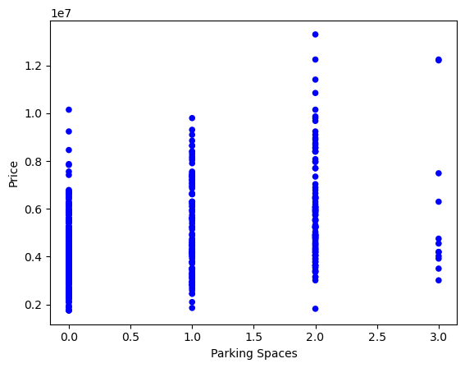
Scatter plot and values (Covariance, Correlation, and Spearman Correlation) comparing the dependent variable (Price) against an explanatory variable (Parking)
Covariance
618330.69
Correlation
0.38
Spearman Correlation
0.37

Slide 16
Permutation Test results between Area and Price
The pvalue of this test is 0.0 The actual correlation value is 0.5359973457780802 The largest value seen under the simulation is 0.14230594749565526

Slide 17
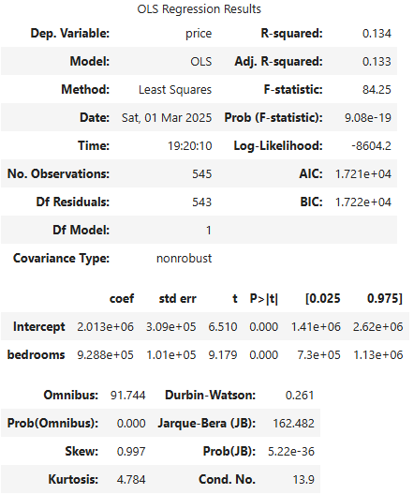
Regression Analysis between Price (dependent variable) and Bedrooms (explanatory variable)

